Slide 1
FPGA’s Band
吳欣祐、林珈卉

Slide 2
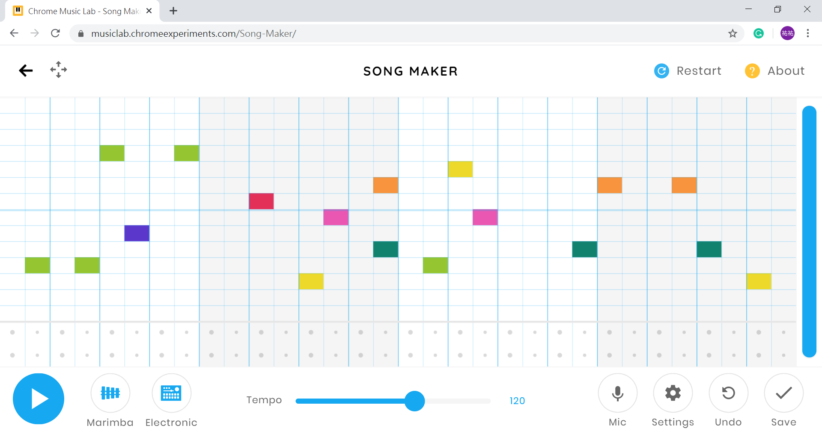

Slide 3
I/O
Input/Output | Describe
Switch 0 | reset
Mouse | Choose the audio track/ Input music data
Bottom | Volume control/play control
LED | Show the current value of volume
7-Segment Display | Show the current pitch
VGA | Output screen signal
Audio Amplifier | Output music
Volume
up
play /
pause
stop
Back
to
Home
Screen
Volume
down

Slide 4
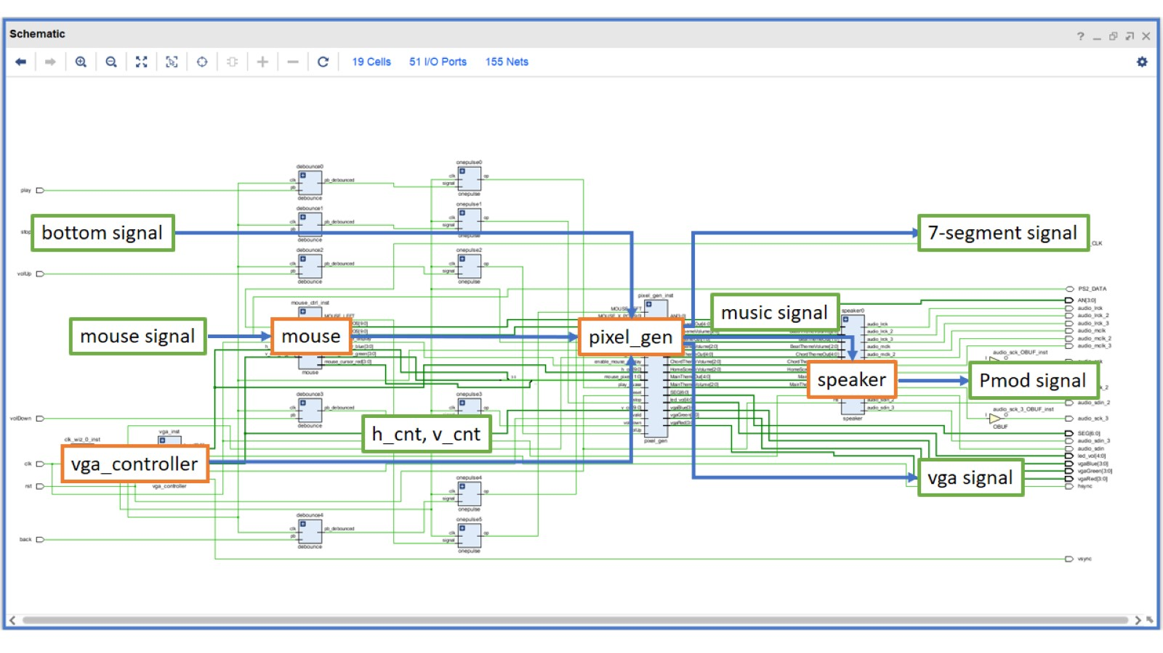

Slide 5
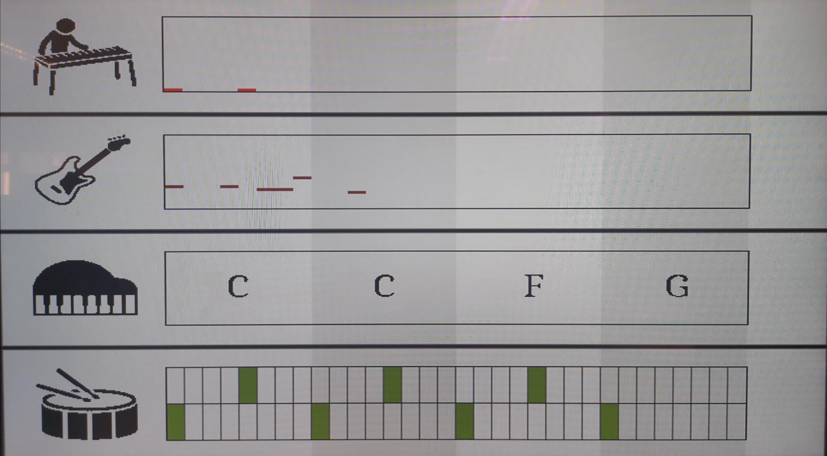

Slide 6
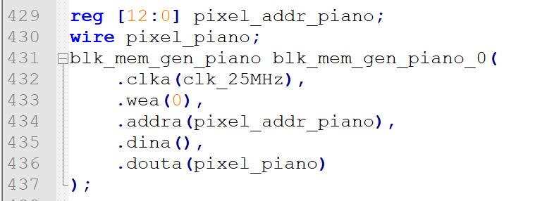

Slide 7
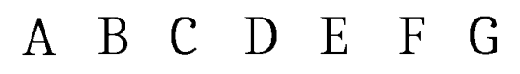





Slide 8
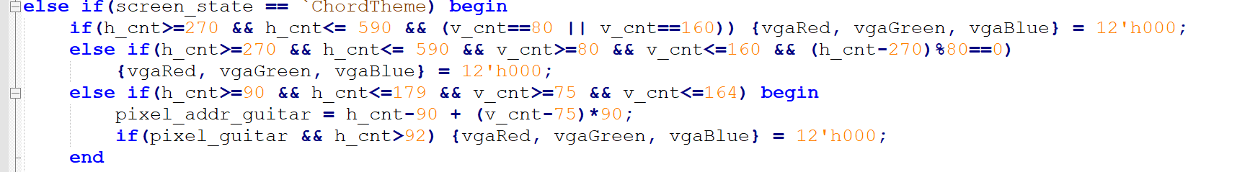

Slide 9
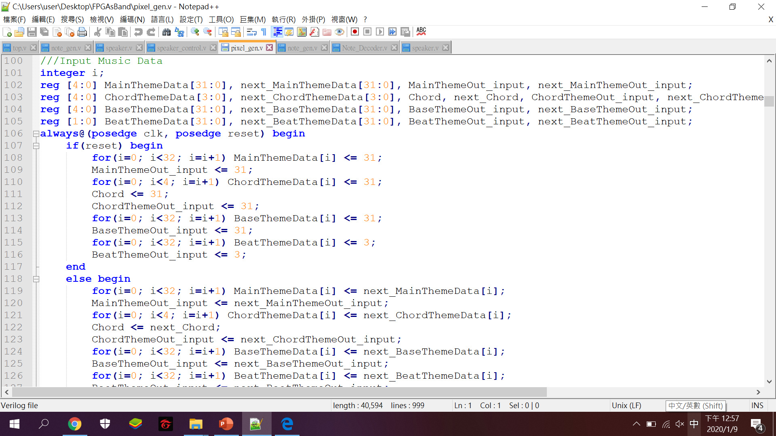
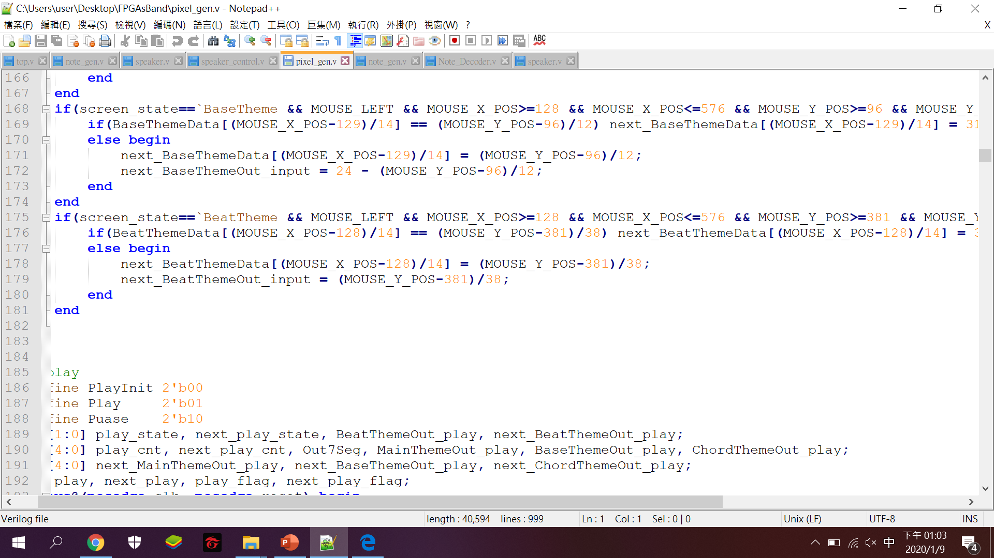

Slide 10
Play control
reset
init
play
stop
pause
stop
pause
FSM
play
stop
play
pause
Play_cnt
play

Slide 11
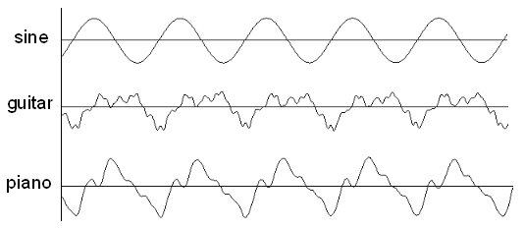

Slide 12


Slide 13
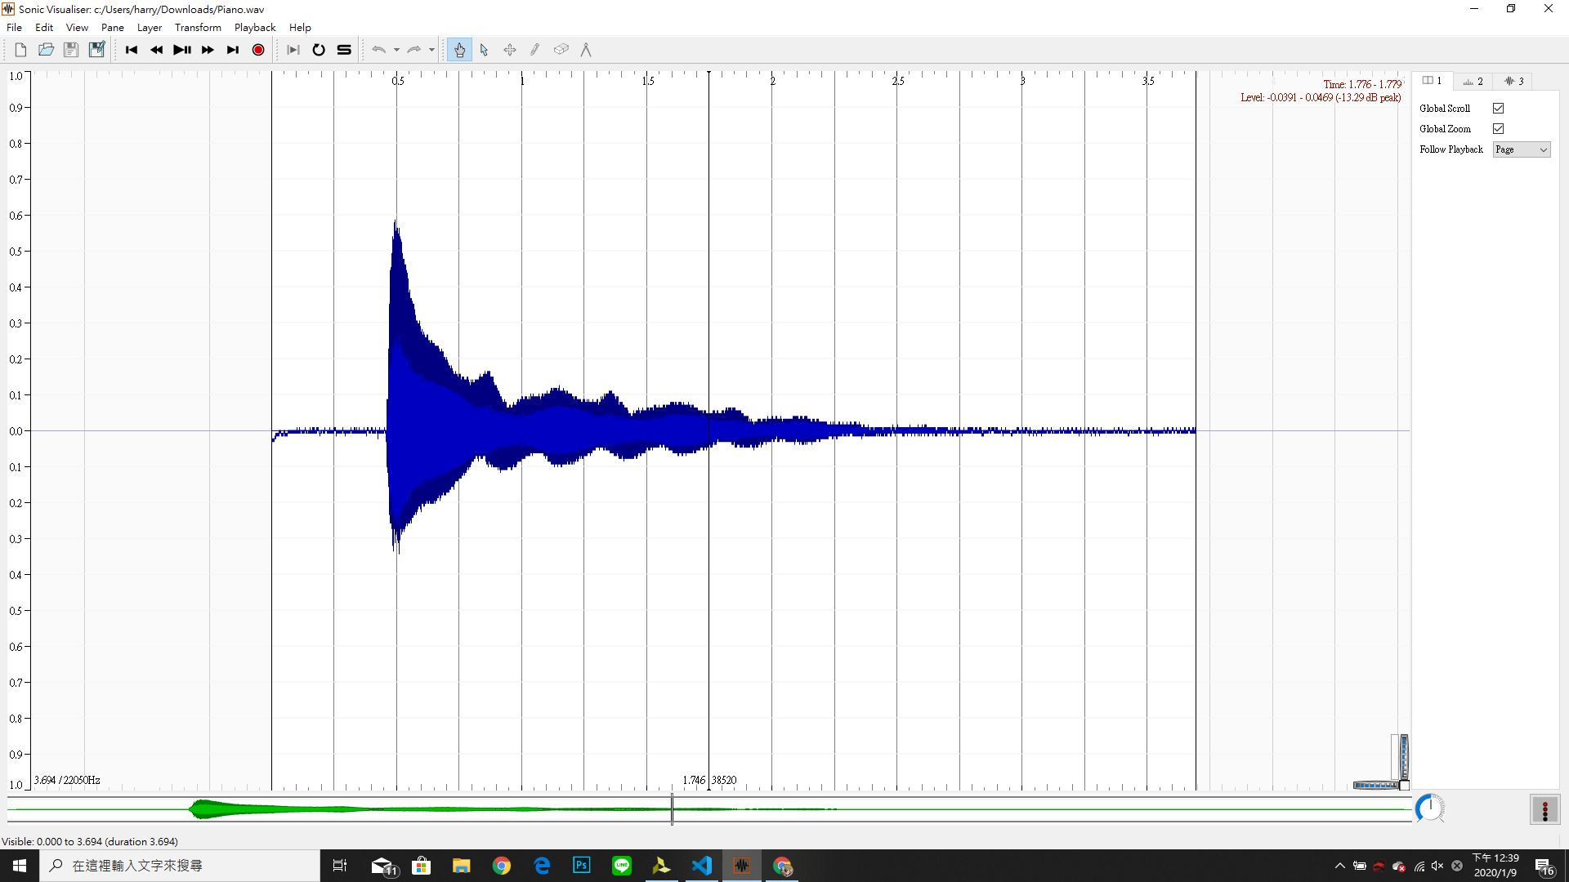

Slide 14
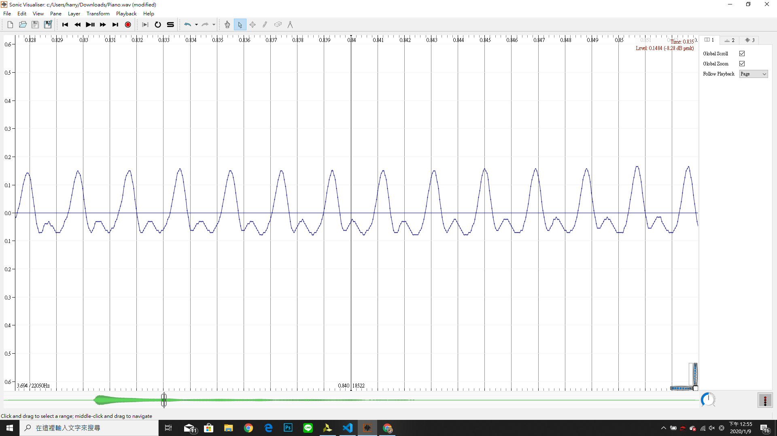

Slide 16
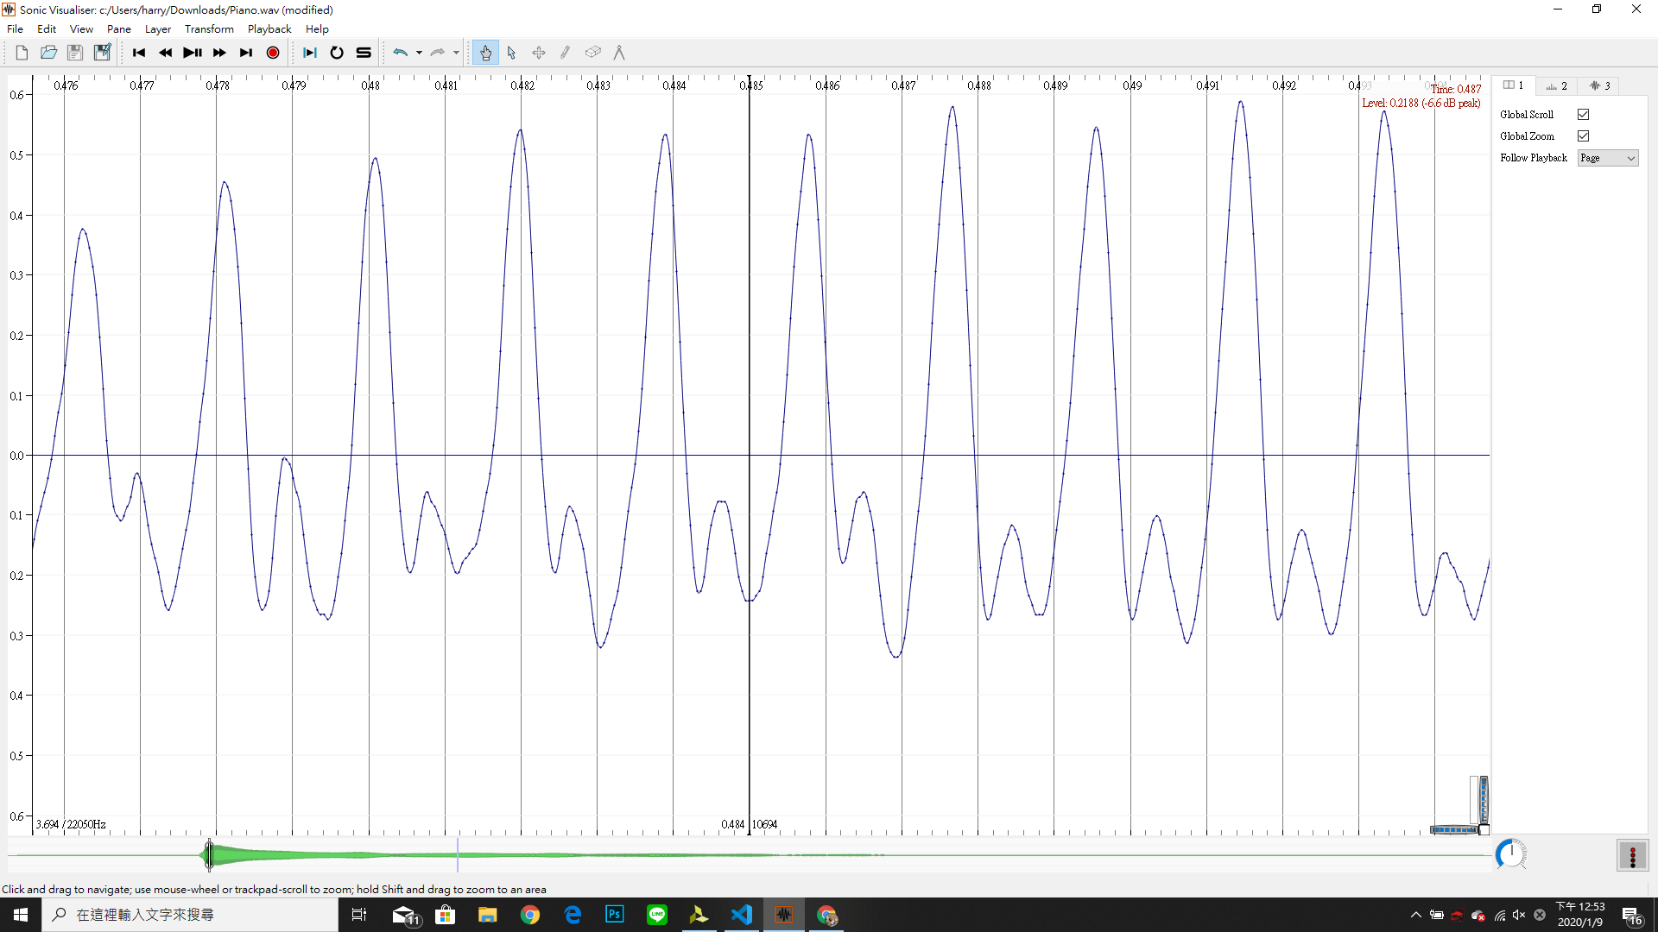

Slide 17
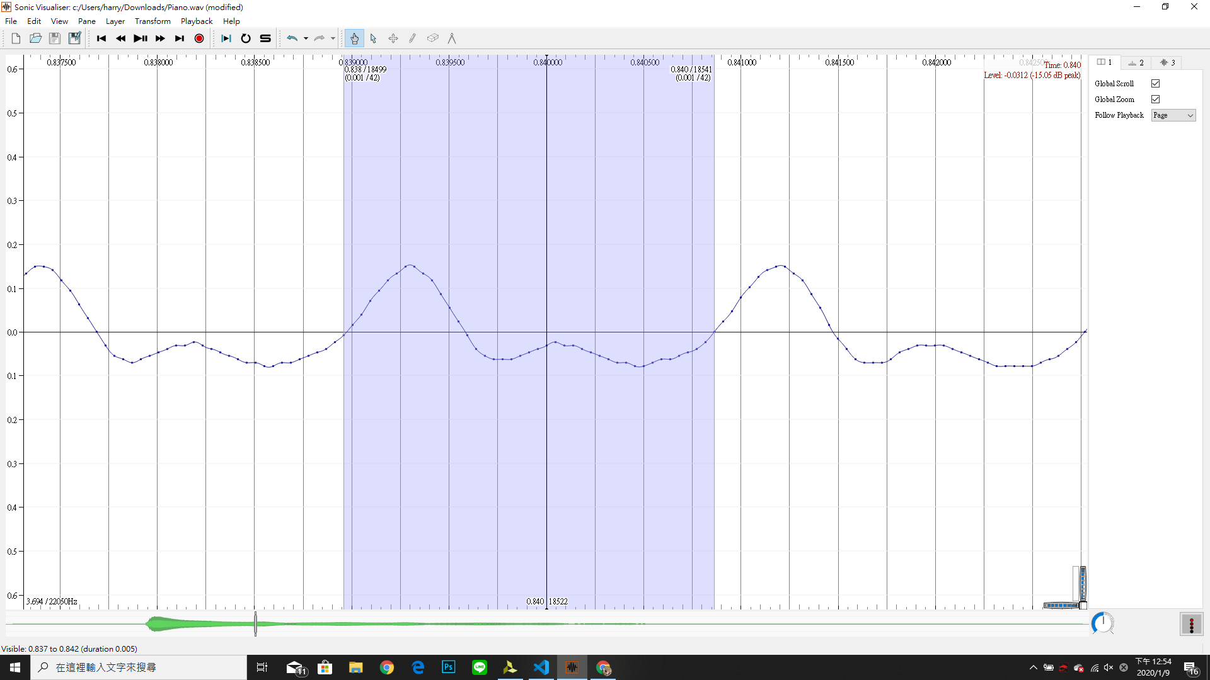

Slide 18
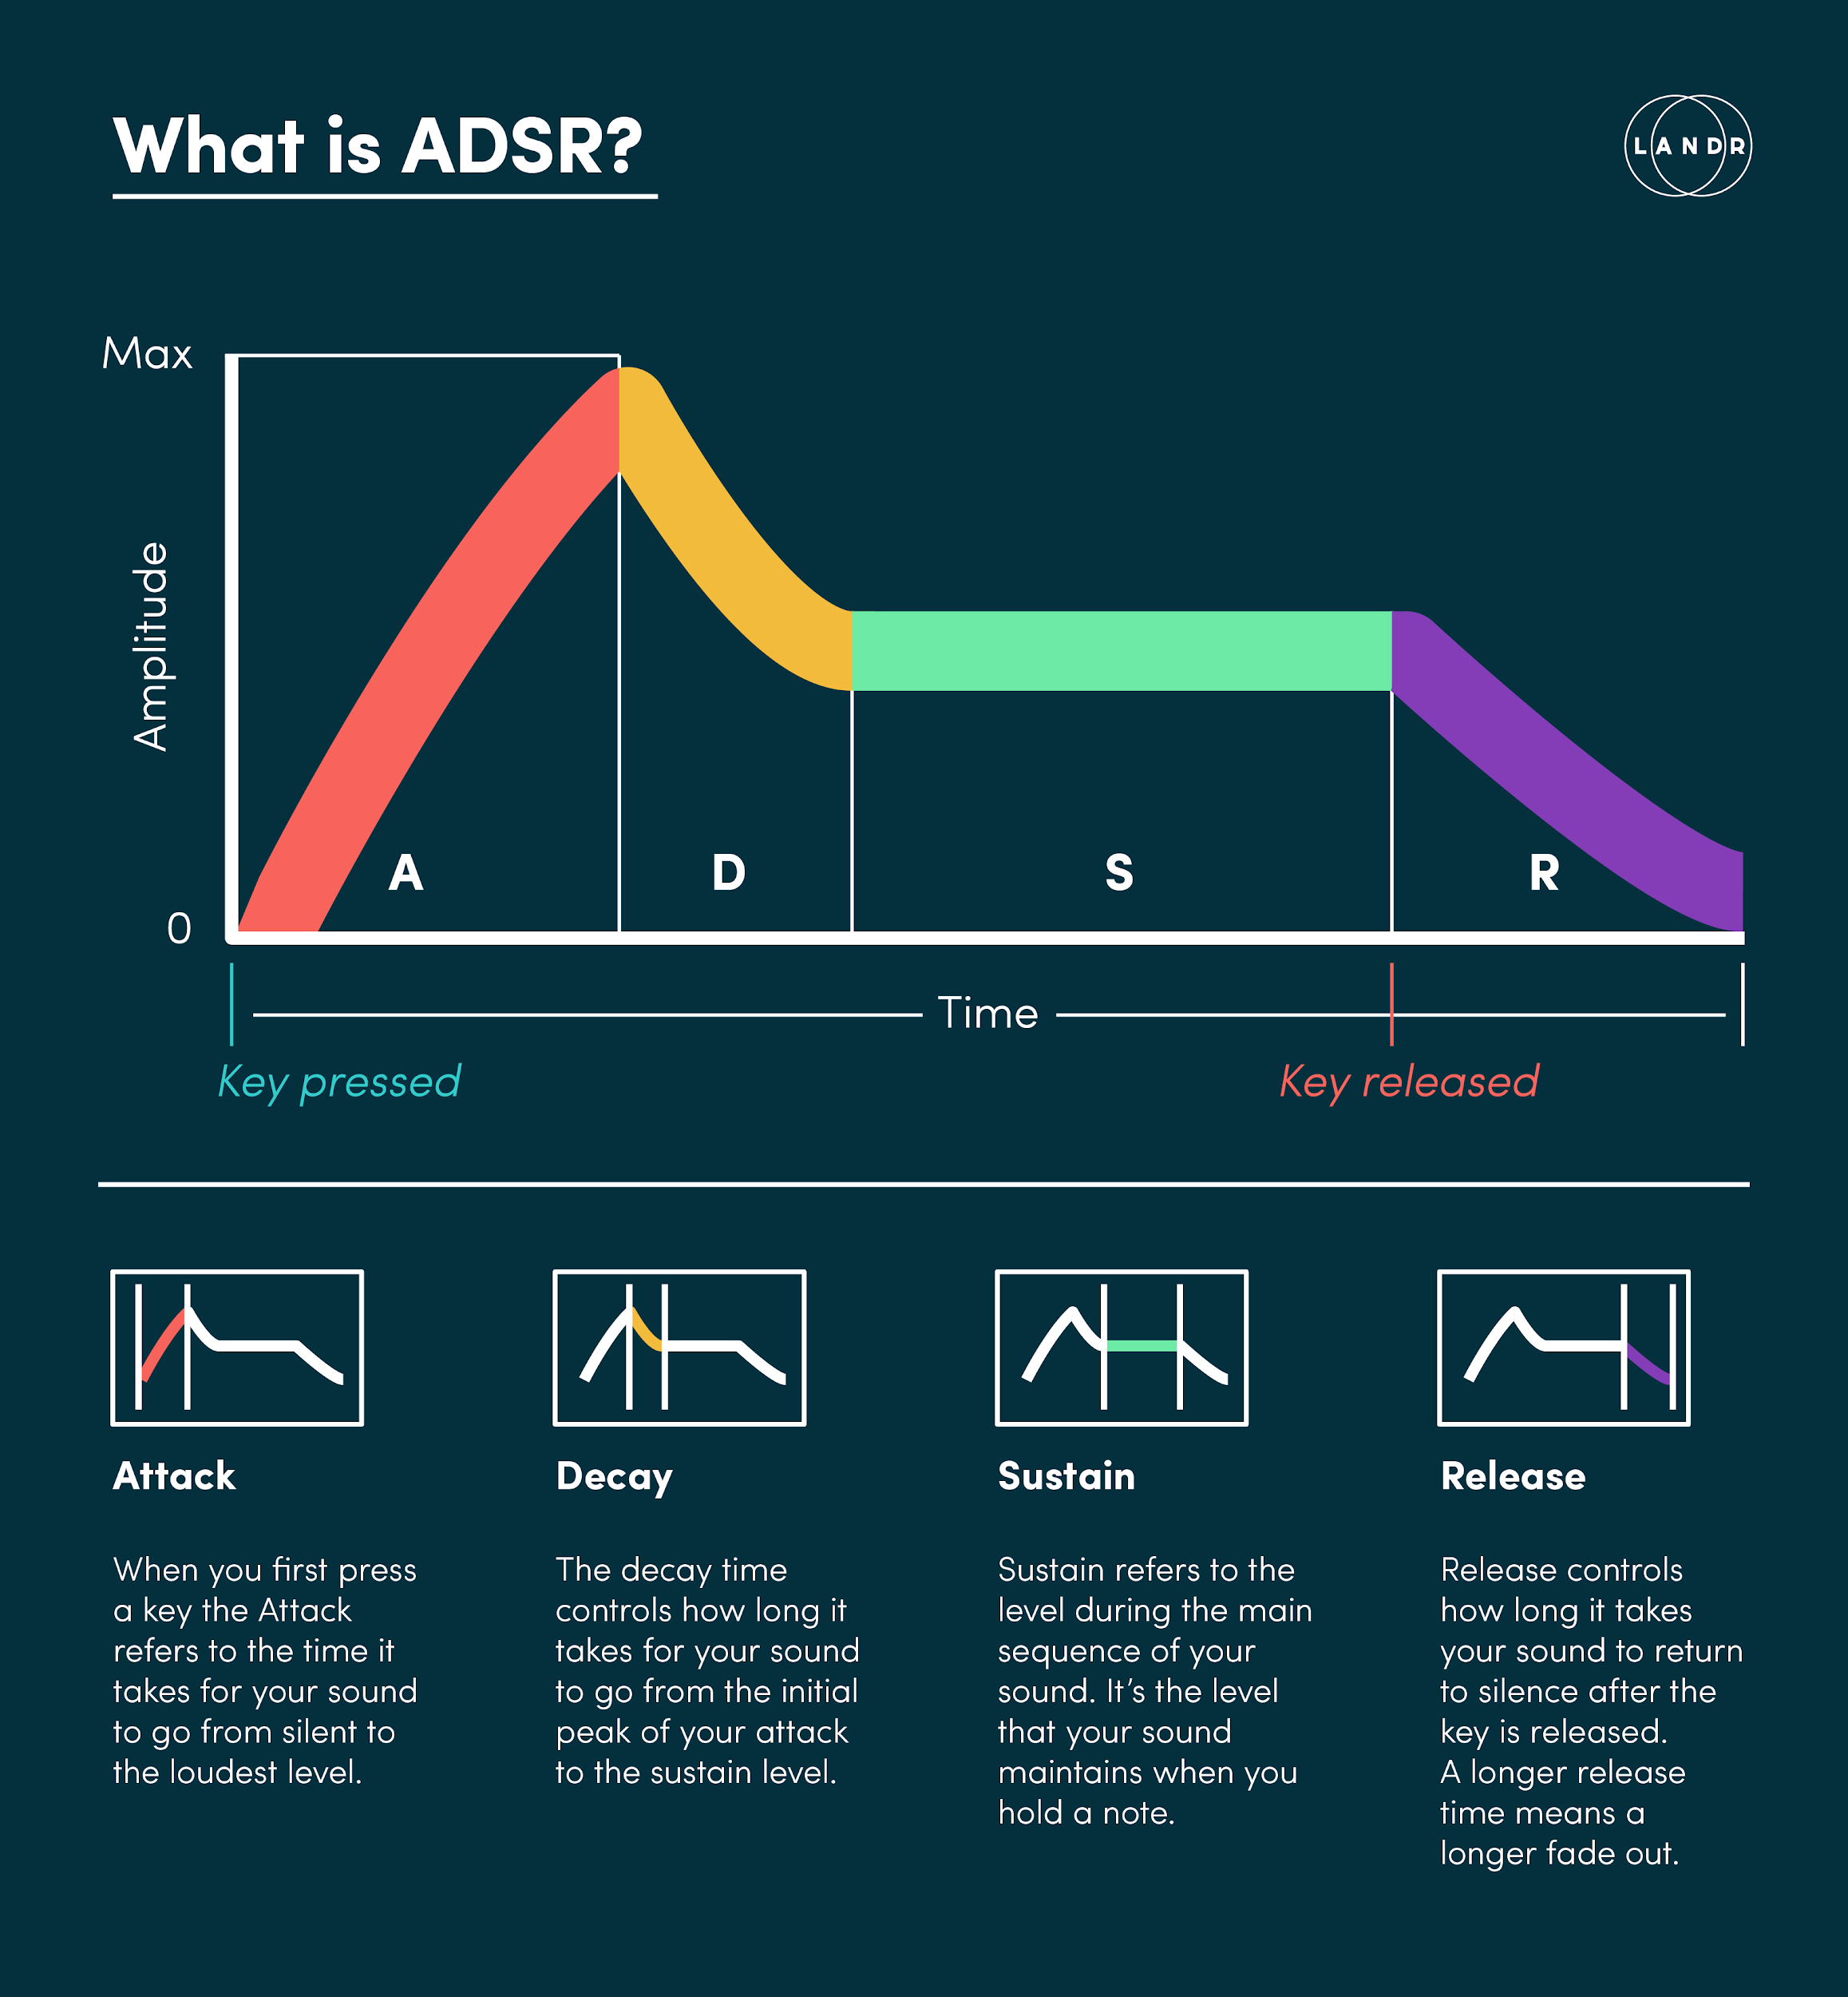

Slide 19
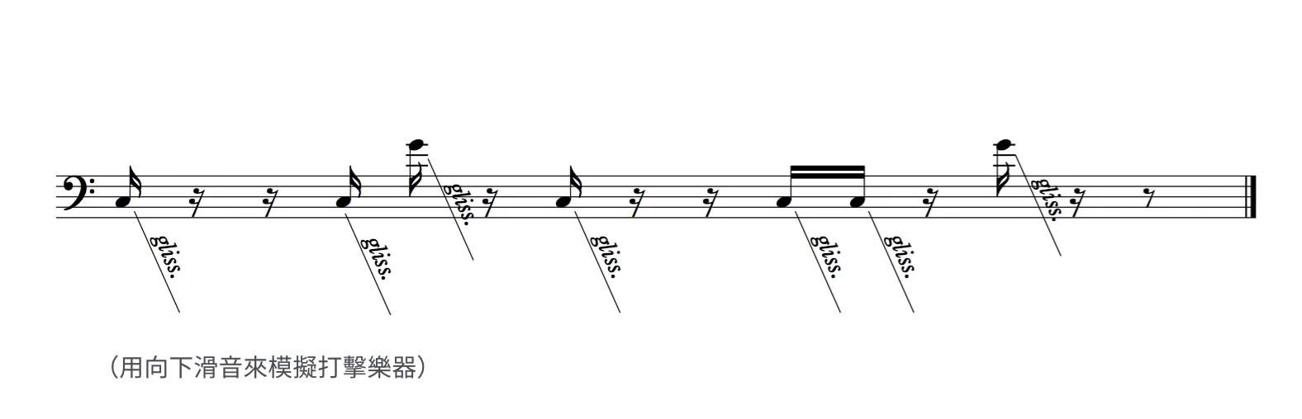
https://www.youtube.com/watch?v=4oh5rHcRgDU

Slide 20
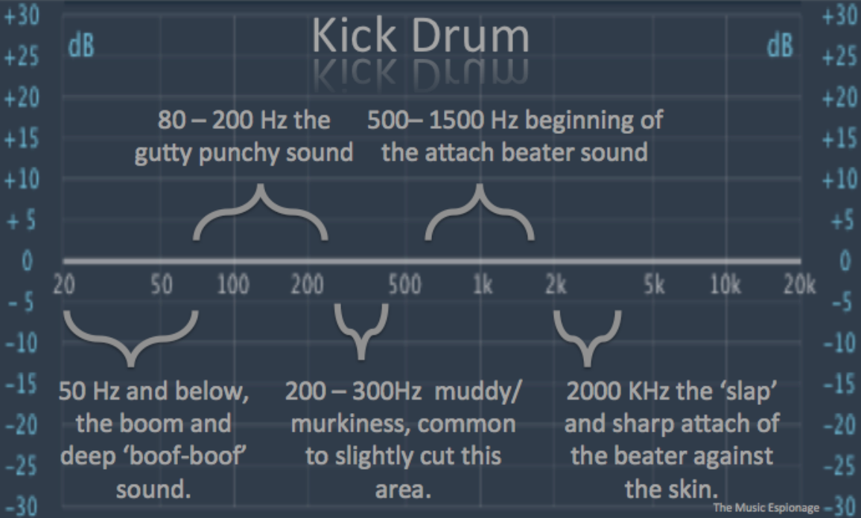

Slide 21
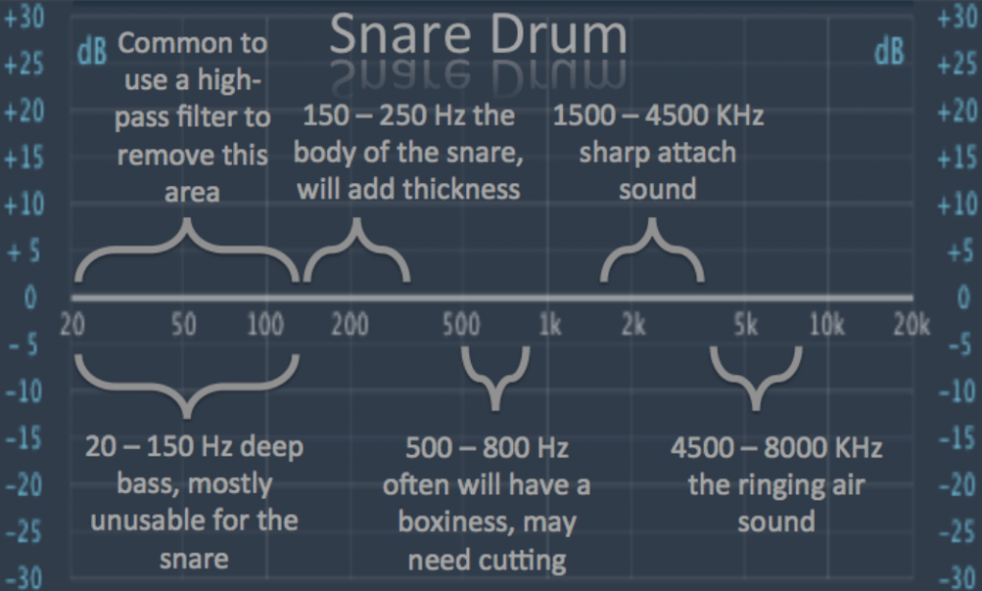

Slide 22
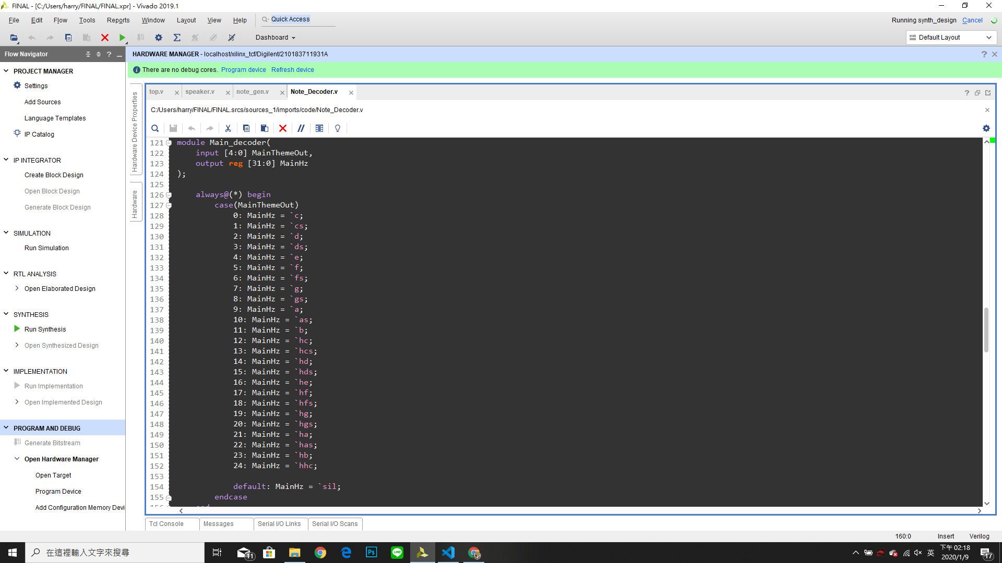
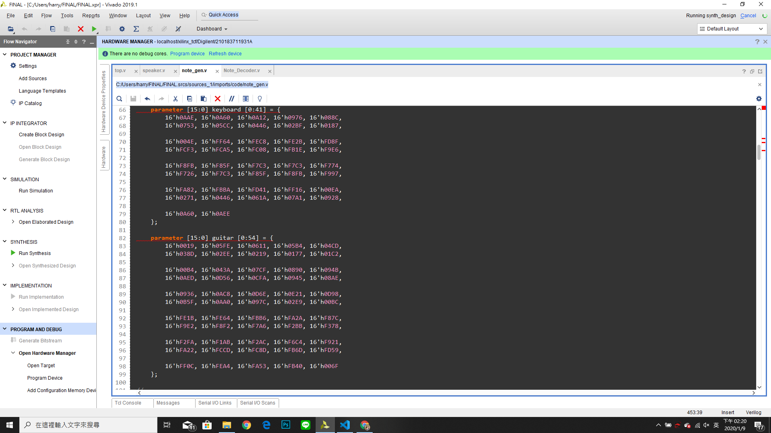
Number -> frequency
Tone

